Slide 1
RDBMS
Relational Database Management Systems
CS/IT 490 WD, Fall 2013

Slide 2
Video Introduction
How relational databases work, lynda.com:
http://www.youtube.com/watch?v=z5YnKt2aOCs
W3Schools guide:
http://www.w3schools.com/sql/default.asp

Slide 3
Normalization
Let's say your company wants to store data, and decide to use a Spreadsheet in lieu of a database.
That might look like this:

Slide 4
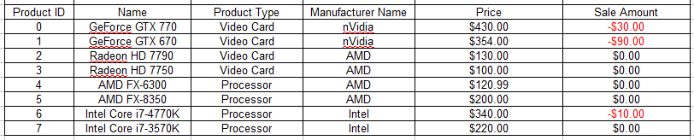
Normalization

Slide 5
Normalization
Note that the “Product Type” and “Manufacturer Name” contain duplicate data – Video Card, Processor, etc.
Any time we're dealing with strings, it's very easy to have typo errors.

Slide 6
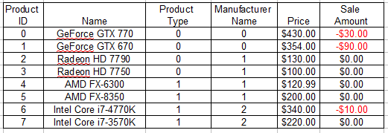


Normalization
Instead, we would want to store “Video Card” and “Processor” separately, where we can identify each with a number ID.
This is similar to how we could use an Enumeration in C++

Slide 7
Normalization
There are multiple levels of Normalization:
  1st Normal Form
  2nd Normal Form
  3rd Normal Form
  And more, but we usually only care about 3rd normal form.

Slide 8
Normalization
1st Normal Form:
No duplicate data in tables. This leads to modification confusion (WHICH do you update?), possible typo errors
Create multiple tables; group data that is related in one table.
Each row has a unique identifier – could be a primary key, or a series of columns forming a primary key.
http://databases.about.com/od/specificproducts/a/normalization.htm

Slide 9
Normalization
2nd Normal Form:
Remove duplicate subsets of information in our table rows, place in separate tables.
Have relationships between these tables with foreign keys
Similar to using the “Product Type” table and pointing to the “Product Type ID”.
http://databases.about.com/od/specificproducts/a/normalization.htm

Slide 10
Normalization
3rd Normal Form:
Remove the columns that are not dependent on the primary key.
  Don't store excess information in one table!
  A “Student” record doesn't really need to be storing their Address – Address can go in a separate table and point to a specific student via Student ID.
http://databases.about.com/od/specificproducts/a/normalization.htm

Slide 11
SQL Queries
You will usually interact with your MySQL database via a user interface.
  PHPMyAdmin for MySQL on the web
  SQL Server for Microsoft's SQL Server
  SQLite Browser
  Etc.
You will also access and modify the database via queries, which are strings.

Slide 12
SQL Queries
Usually, you will pre-build your database with a GUI tool, and not be creating/dropping tables from your PHP code.
Then, you'll use SQL Queries to ask for information from those tables, or insert, update, or delete information.

Slide 13
Table Modification
Create Table
  Allows you to create a table in your database.
  Must specify column names, attributes of those columns (primary key, not null, etc.)
Alter Table
  Modify an existing table
Drop Table
  Remove table & all its data

Slide 14
Data Modification
Insert
  Insert data into a specific table
Update
  Update existing data based on some criteria; “where price > 20.00”
Select
  Select data from one or more tables
Delete
  Remove a record from the database

Slide 15
Data Modification
We will go over how to write queries in another lecture.

Slide 16
Relationships between Tables
Relationships between tables is one of the core reasons for using an “RDBMS” solution.
Otherwise, if our data weren't related to other data, why wouldn't we just save everything in a text file?

Slide 17
Relationships between Tables
Relationships could be:
  Employee → Employee (Boss)
  Product → Brand
  Student → Student/Class → Class
If we didn't have primary keys and foreign keys set up, we would have to parse all of the data to try to find matches in the criteria.
The database already does this for us, much more efficiently than we could!

Slide 18
Some Column data types
Integer
Varchar
Bool
Float
Decimal
Date
Time
Datetime
Varchar
Binary

Slide 19
DB Schema Diagrams
Download Dia, a gratis, open source diagramming tool, available for Windows, Linux, & Mac from:
http://dia-installer.de/
Or:
http://portableapps.com/apps/office/dia_portable
(Gratis means without charge. “Free” software could be gratis or libre, so that word gets confusing. Yes, I'm channeling RMS here)

Slide 20
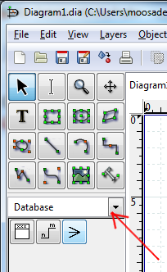
DB Schema Diagrams
In Dia, select “Database” from the Dropdown box.
UML could be useful for diagramming programs.
Hey, there are only three buttons for databases!

Slide 21

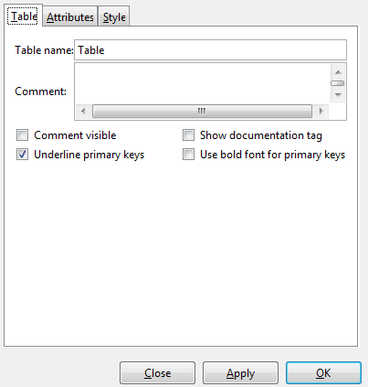
DB Schema Diagrams
Select the first button and click on the empty grid area, an empty table diagram will show up.
Double-click that table to edit it.

Slide 22
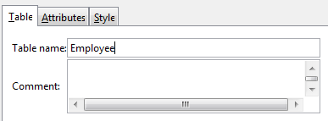
DB Schema Diagrams
Give the table a name:

Slide 23
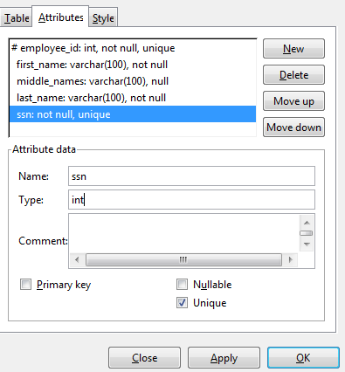
DB Schema Diagrams
And under Attributes, we can set up the column information.
DO NOT STORE Social Security Numbers as plaintext in a database!
This is just an example!
Column Name
Data type (int, varchar, ...)
Properties: is it a primary key?
Can it be null or must it be filled in?
Does it have to be unique from all the other rows?

Slide 24
DB Schema Diagrams
And under Attributes, we can set up the column information.
employee_id is set as the primary key,
which automatically sets the not null and
unique attributes.
first_name and last_name are not null
(they must be filled in), but the
middle_names field is optional.
ssn is not null, and must be unique,
because no two people should have the
same social security number.

Slide 25

DB Schema Diagrams
Once we have multiple database tables, we can mark a “relationship” between them with the second button:

Slide 26
DB Schema Diagrams
Once we have multiple database tables, we can mark a “relationship” between them with the second button:

Slide 27
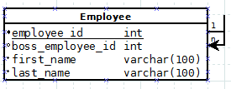

DB Schema Diagrams
A table can be related to itself:
Or another table:

Slide 28
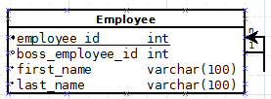
DB Schema Diagrams
Notice the small “1” and “n” markers, and where the arrow points.
These represent “1-to-n” relationships.
One boss can have many employees
  (1 Boss : n employees)

Slide 29
DB Schema Diagrams
1 Manufacturer : n Products
You can also have a 1-to-1 relationship
  1 Person might have 1 Email Address that we store, and each 1 Email Address belongs only to 1 Person.
  Note that “Email address” could also be a column in a “Person” table.
  But, if you make “Email address” belong to a separate, 1 : 1 table, you avoid any NULL values in the Person table.

Slide 30

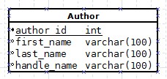
DB Schema Diagrams
n : n relationships (many-to-many)
An author can have many books, and a book can have multiple authors.
However, you cannot simply change the “1 / n” line on the diagram tool, and you cannot just mark a “n:n” flag in the database.
You need to design it in a specific way...
How can we relate to each other?

Slide 31
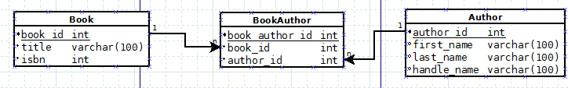
DB Schema Diagrams
With an n : n relationship, you need to have an intermediate table to store the combination of the two:
The Book table has a 1 : n relationship with the BookAuthor table, and the same with Author.
Now we can have a series of records that combine a BOOK ID and an AUTHOR ID. We can have multiple Book IDs and multiple Author IDs.
This gives us a n : n relationship.

Slide 32
Design Notes
I will usually name my primary keys [tablename]_id.
  This is because when you're doing queries with JOIN, it will make identifying each column easier, rather than having duplicate “id” columns!
  It also makes matching the foreign-key/primary-key more explicitly clear.
I usually name my n : n intermediate tables [table1][table2].
  It helps you know what two tables are linked.

Slide 33
Let's create some schema diagrams!
For posterity

Slide 34
References
-

